Slide 1



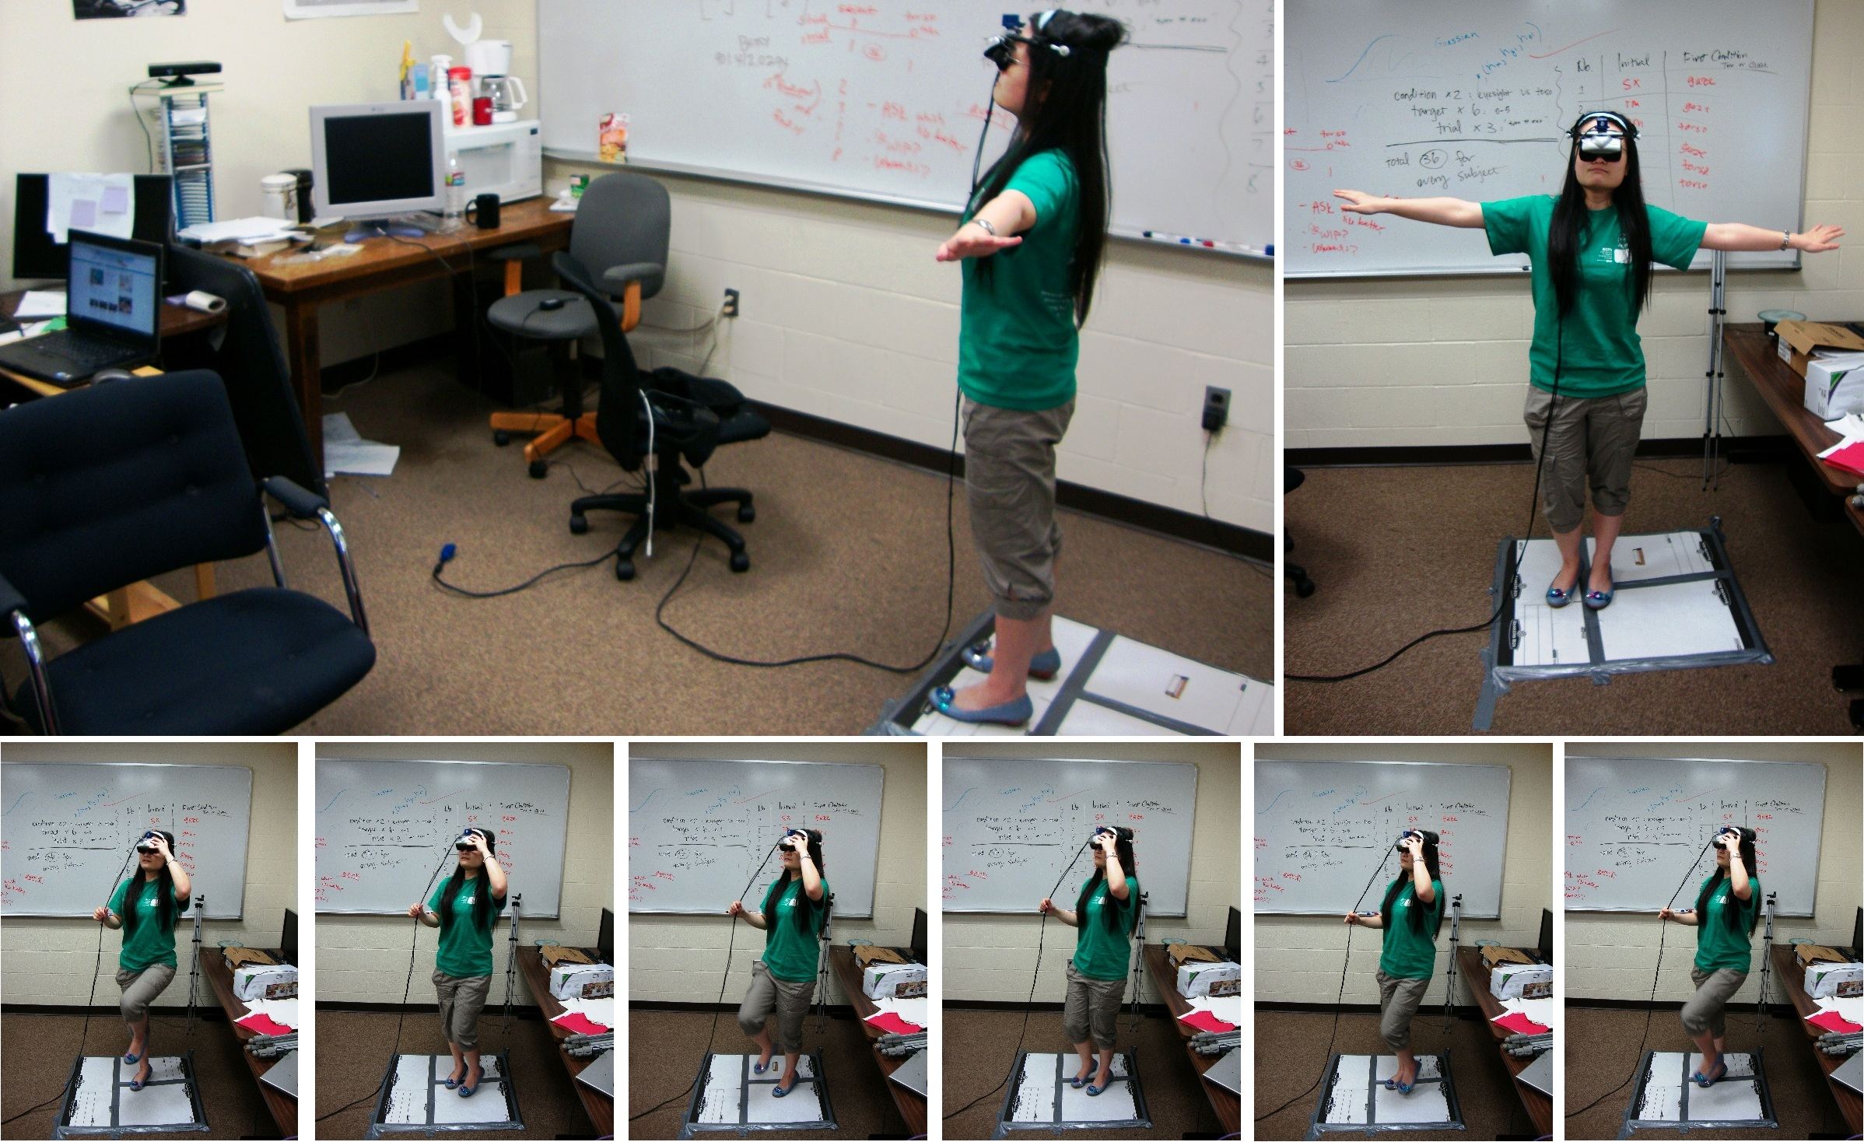
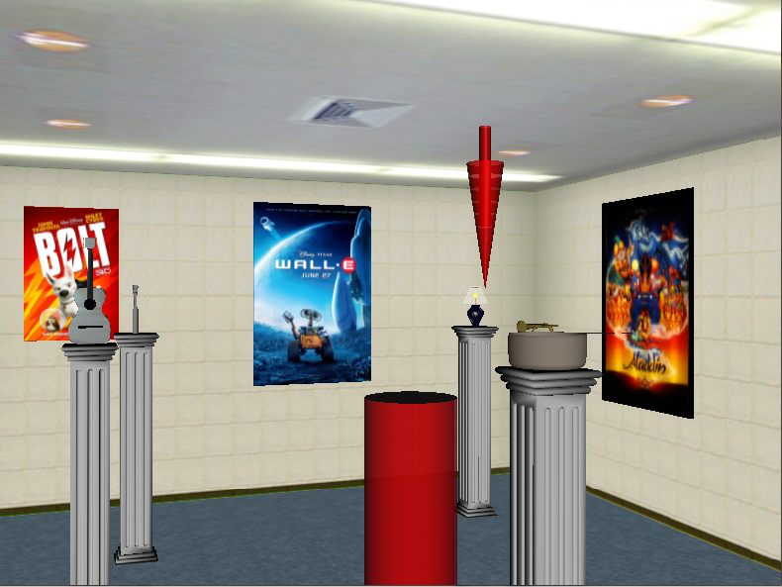
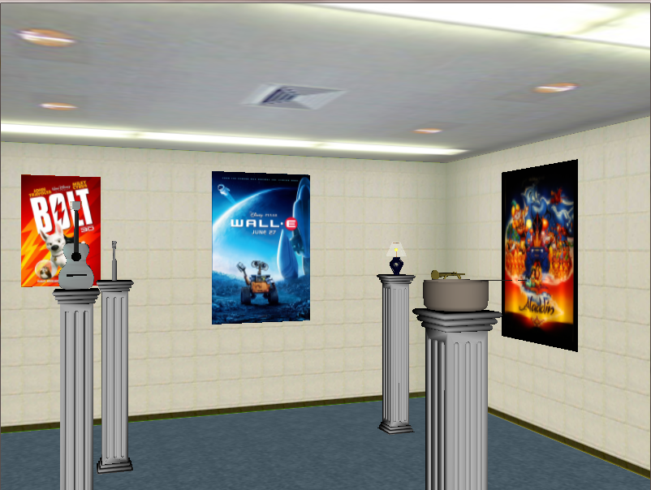
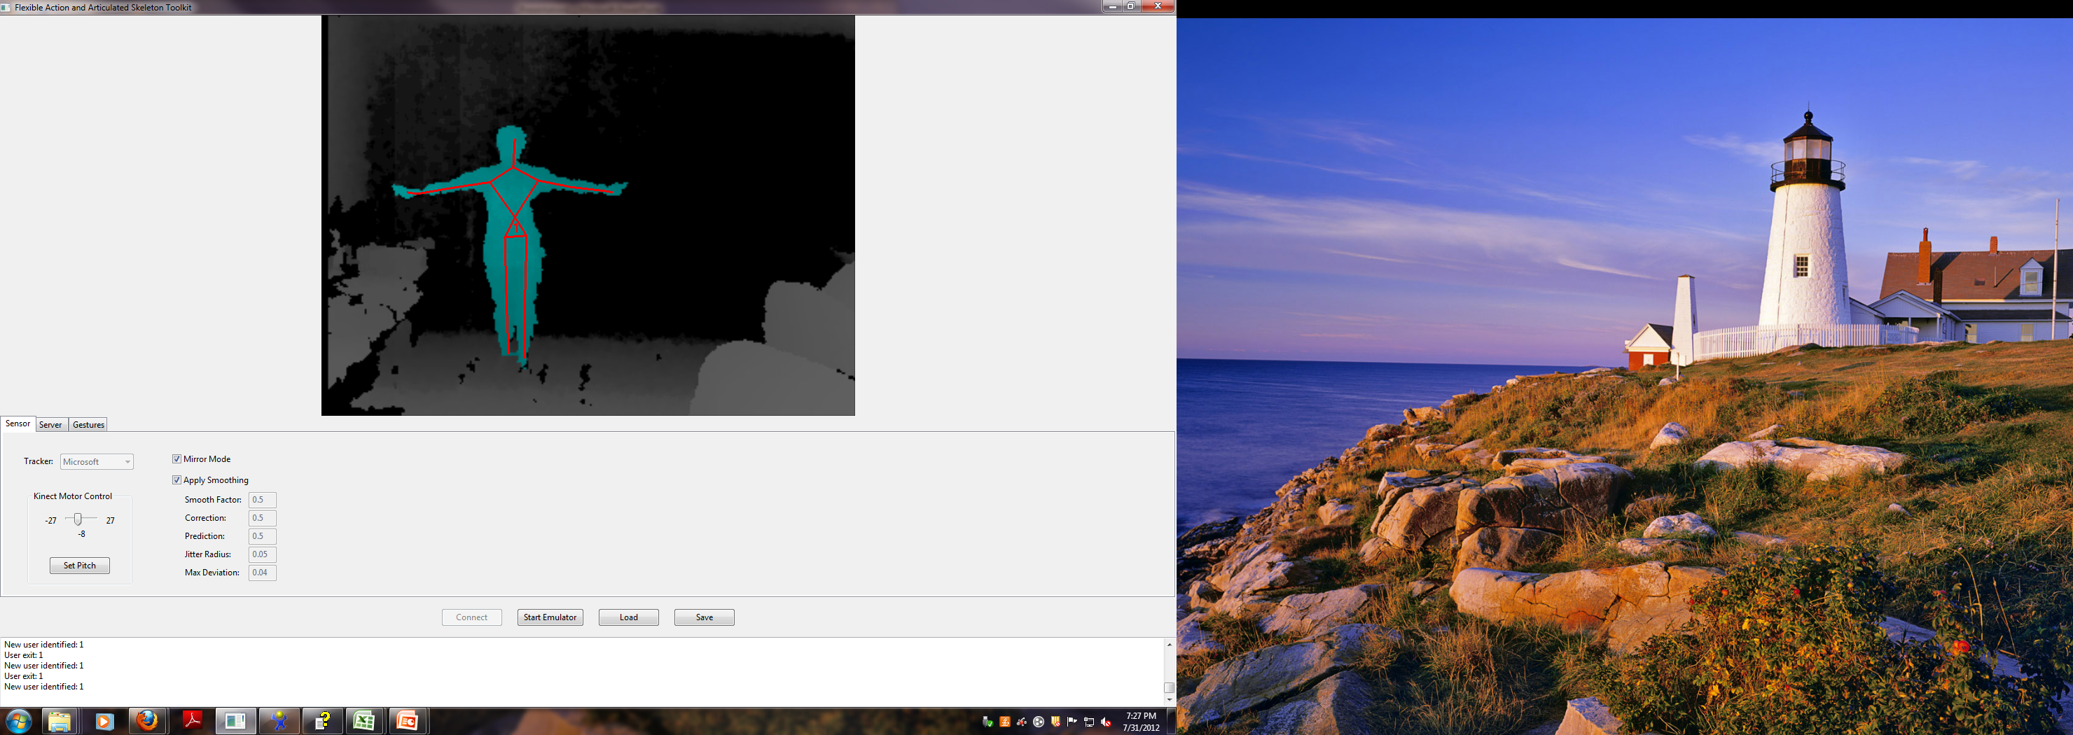
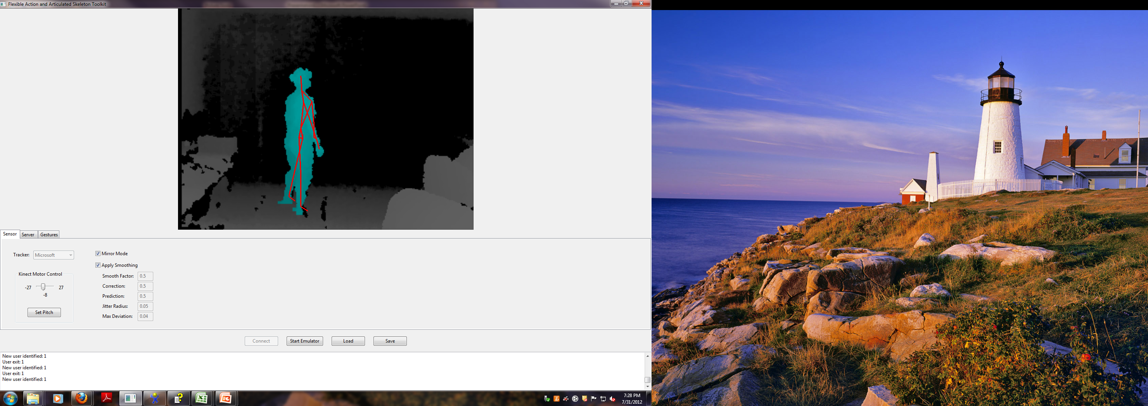
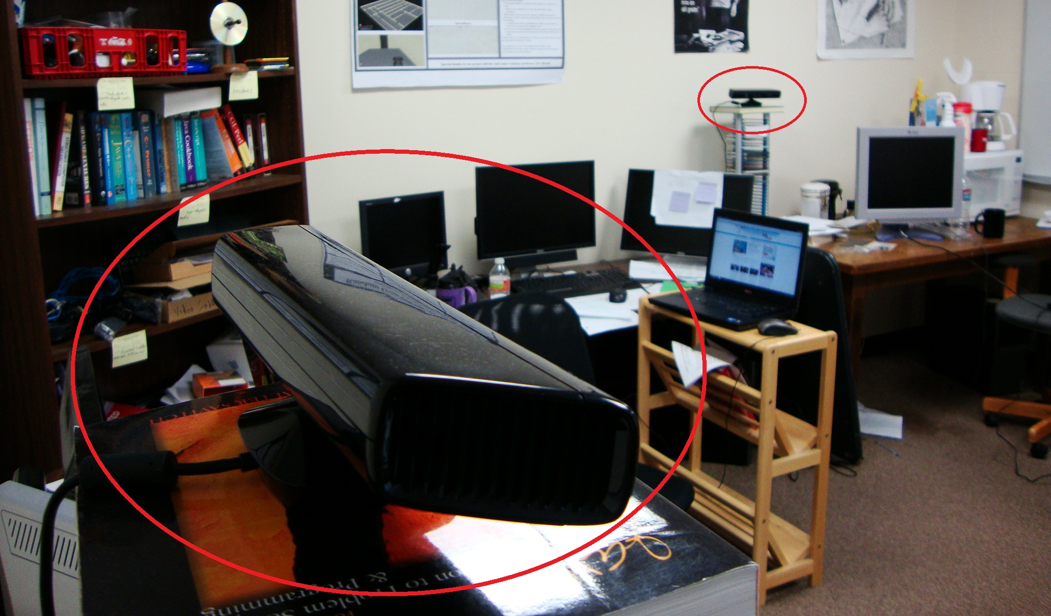
Exploring a Virtual Environment by walking in place using the Microsoft Kinect
Matthew McCaleb, Ye Zheng, Courtney Strachan, Betsy Williams
e-mail:sandersb@rhodes.edu - Department of Computer Science, Rhodes College, Memphis, TN
Goal
Results
Investigate an inexpensive method of navigating a virtual environment with a Head-Mounted display (HMD) while maintaining good spatial awareness of the environment
Walking in Place (WIP)
Participants lift feet in a natural walking motion, and translate in the virtual environment as their foot leaves the ground
Advantages:
Allows exploration of large virtual environments
Less expensive than other methods (normal walking, redirected walking, omnidirectional treadmill, etc.
Might provide some of the proprioceptive cues of walking
All 6 subjects preferred Gaze direction based navigation to torso-direction based navigations.
Figure 2: Test subject wearing HMD while performing K-WIP
Two Modes of Translation
Participant Comments
Translation based on Torso direction:
Allows the participant to look around the environment without changing direction
Translation based on Gaze direction:
Allows users to walk directly towards objects of interest
“I play video games a lot and I feel more accurate using a controller but I feel more natural using the WIP”
“I found this task a lot less confusing than video games.”
Previous Research
WIP on Wii [Williams et al.]:
Showed that subjects have better spatial awareness than using a joystick and similar spatial awareness to foot exploration
Less expensive WIP implementation but has approximately 1 step lag in step detection
WIP using motion capture data [Feasel et al.]:
In a usability study, found WIP is not as good as walking but just as good as using a joystick
Conclusions
Experimental Evaluation
WIP seems to be an effective method for virtual environment exploration.
Step detection of K-WIP does not have as much lag as the Wii-WIP [Williams et al.].
Interestingly, translation in Gaze direction based is preferred, even though translating in the torso facing direction mimics real walking more closely.
We report surprisingly small turning errors, even though we used one of the least expensive HMDs on the market.
Use a spatial awareness task to compare the two different modes of translation to find which is most effective for WIP
Materials
Two Microsoft Kinect systems (150 USD)
eMagin Z800 HMD (40° diagonal FOV)
Our WIP method: Kinect WIP(K-WIP)
Microsoft Kinect
Uses built in depth camera to track skeletal movement
Our Method:
Detects a step when the user’s feet reach a certain threshold and translates the user forward at 1 m/s.
Problem using one Kinect: only accurate in a 60° range
Solution: Use two Kinect
systems 90° apart and
alternate trackers during
rotation
Future Direction
First, we plan to improve our step detection algorithm to translate the user forward at variable speed according to how fast they step.
Then we plan to compare K-WIP to other methods of exploring virtual environment (joystick, walking, Wii-WIP, etc).
Figure 3: Virtual environment, with testing an example testing location and target objects
Method
References
VS
Six subjects participated in a counterbalanced within-subjects design
Conditions:
K-WIP with gaze direction translation
K-WIP with torso direction translation
Task:
Memorize location of 6 target objects
Locomote to six different positions in the environment and turn to face three remembered targets (18 trials)
Turning error and latency were recorded
FEASEL, J., WHITTON, M. C., AND WENDT, J. D. 2008. Llcmwip: Low-latency, continuous-motion walking-in-place. In Proceedings of the 2008 IEEE Symposium on 3D User Interfaces, IEEE Computer Society, Washington, DC, USA, 3DUI ’08, 97–104.
SLATER, M., USOH, M., AND STEED, A. 1995. Taking steps: The influence of a walking technique on presence in virtual reality. ACM Trans. on Human Interaction 2, 3, 201–219.
WILLIAMS, B., BAILEY, S., NARASIMHAM, G., LI, M., AND BODENHEIMER, B. 2011. Evaluation of walking in place on a wii balance board to explore a virtual environment. ACM Trans. Appl. Percept. 8, 3 (Aug.), 19:1–19:14.
Figure 1: The two Kinects (circled) are placed 90 degrees to each other.

